Slide 1
Unit 3: Java Servlets and XML

Slide 2
What are Servlets?
Java Servlets are programs that run on a Web or Application server and act as a middle layer between a requests coming from a Web browser or other HTTP client and databases or applications on the HTTP server.
Through Servlets, you can collect inputs from users via web page forms, retrieve records from a database or another source and create web pages dynamically.

Slide 3
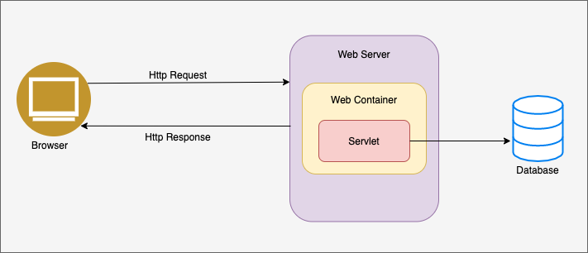

Slide 4
Advantages of Servlet
Performance is significantly better.
Servlets execute within the address space of a Web server. It is not necessary to create a separate process to handle each client request.
Servlets are platform-independent because they are written in Java.
Servlets can be created to support any of the protocols like FTP commands, Telnet sessions, etc.
Servlets are compatible with any web server available today.
Servlets can be invoked by web server only, so they inherit all the security measures taken by the web server.
The full functionality of the Java class libraries is available to a servlet.

Slide 5
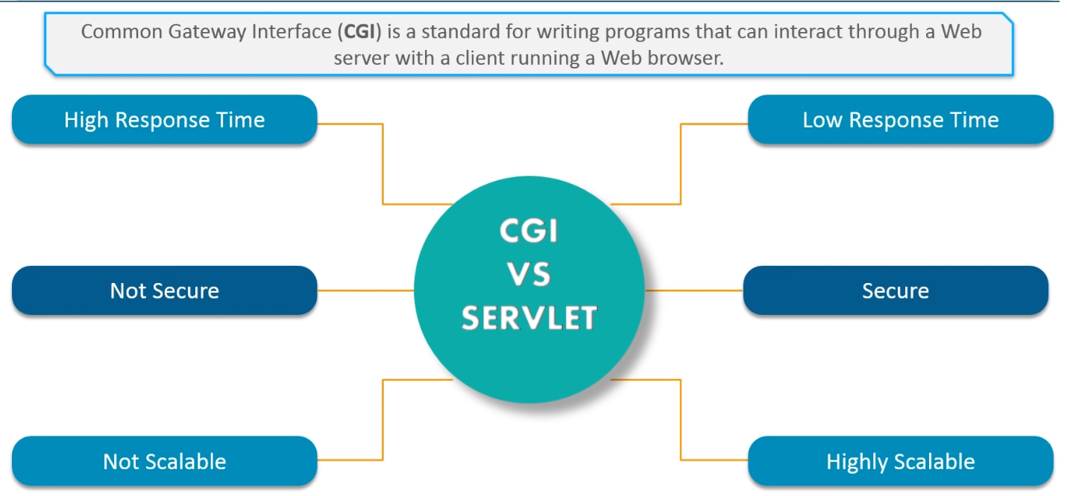
CGI vs Servlet

Slide 6
Servlets Packages
Java Servlets are Java classes run by a web server that has an interpreter that supports the Java Servlet specification.
Servlets can be created using the packages
javax.servlet
javax.servlet.http

Slide 7
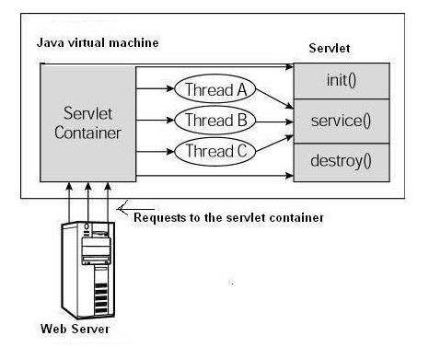
Architecture Diagram
First the HTTP requests coming to the server are delegated to the servlet container.
The servlet container loads & initializes the servlet before directly invoking the service() method.
Then the servlet container handles multiple requests by spawning multiple threads, each thread executing the service() method of a single instance of the servlet.

Slide 8
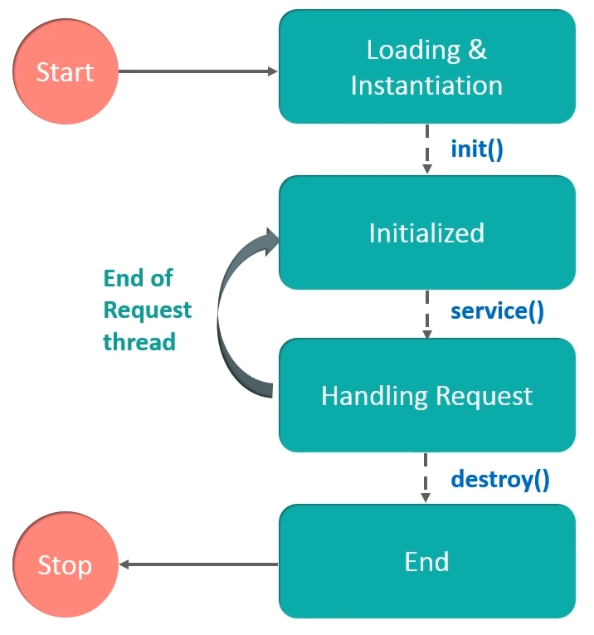
Servlet Life Cycle

Slide 9
Servlet Life Cycle
Servlet class is loaded: The servlet class is loaded when the first request for the servlet is received by the web container.
Servlet instance is created: The container creates the instance of a servlet after loading the servlet class (servlet instance is created only once)
init method is invoked: The servlet is initialized by calling the init() method.
service method is invoked: The servlet calls service() method each time when request for the servlet is received
The servlet is terminated by calling the destroy() method before removing the servlet instance from the service

Slide 10
The init() Method
The init method is called only once.
It is called only when the servlet is created, and not called for any user requests afterwards.
When a user invokes any servlet, a single instance of each servlet gets created, with each user request resulting in a new thread that is handed off to doGet() or doPost(), as appropriate.
The init() method simply creates or loads some data that will be used throughout the life of the servlet.
The init method definition looks like this −
public void init() throws ServletException {
// Initialization code...
}

Slide 11
The service() Method
The servlet container (i.e. web server) calls the service() method to handle requests coming from the client (browsers) and to write the formatted response back to the client.
When server receives a request for a servlet, the service() method checks the HTTP request type (GET, POST) and calls doGet() or oPost() method as appropriate.
Here is the signature of this method −
public void service(ServletRequest request, ServletResponse response) throws ServletException, IOException {….. }

Slide 12
The doGet() Method
A GET request results from a normal request for a URL or from an HTML form that has no METHOD specified and it should be handled by doGet() method.
public void doGet(HttpServletRequest request, HttpServletResponse response)
throws ServletException, IOException {
// Servlet code
}

Slide 13
The doPost() Method
A POST request results from an HTML form that specifically lists POST as the METHOD and it should be handled by doPost() method.
public void doPost(HttpServletRequest request, HttpServletResponse response)
throws ServletException, IOException {
// Servlet code
}

Slide 14
The destroy() Method
The destroy() method is called only once at the end of the life cycle of a servlet.
This method gives your servlet a chance to close database connections, halt background threads, and perform other such cleanup activities.
After the destroy() method is called, the servlet object is
marked for garbage collection.
The destroy method definition looks like this −
public void destroy() {
// Finalization code...
}

Slide 15
Requirements
Before running Servlet your machine requires following tools
1> Eclipse (IDE-integrated development environment)
2> Tomcat (Web Server)

Slide 16
How to configure tomcat server in Eclipse ? (One time Requirement)
If you are using Eclipse IDE first time, you need to configure the tomcat server First.
For configuring the tomcat server in eclipse IDE,
click on servers tab at the bottom side of the IDE -> right click on blank area -> New -> Servers -> choose tomcat then its version -> next -> click on Browse button -> select the apache tomcat root folder previous to bin -> next -> addAll -> Finish.

Slide 17
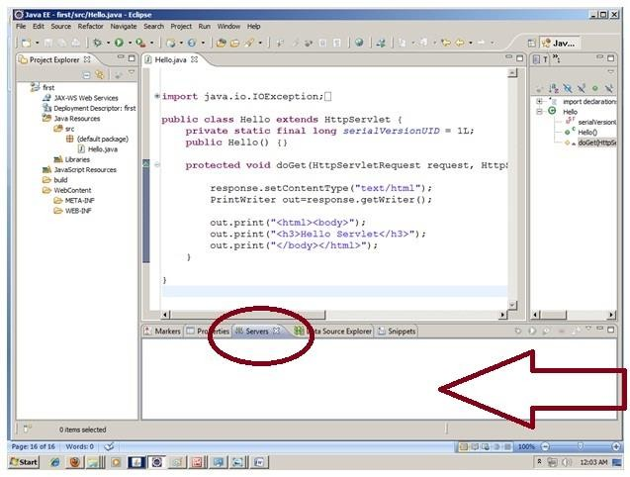
How to configure tomcat server in Eclipse ?

Slide 18
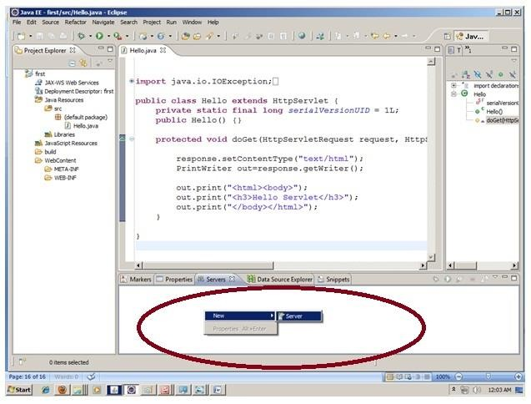
How to configure tomcat server in Eclipse ?

Slide 19
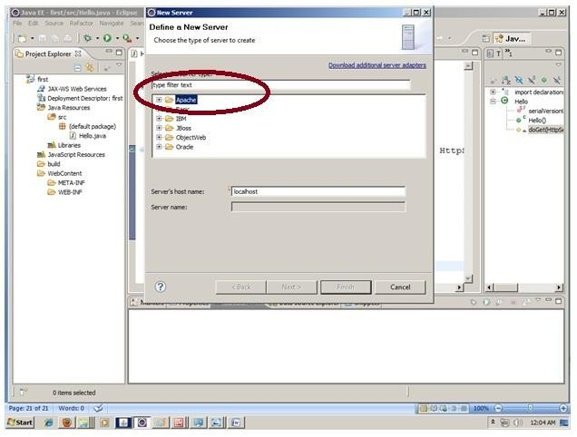
How to configure tomcat server in Eclipse ?

Slide 20
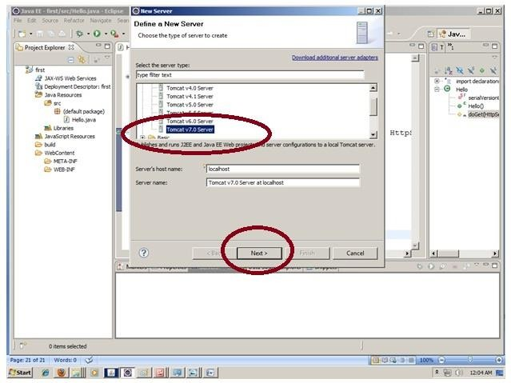
How to configure tomcat server in Eclipse ?

Slide 21
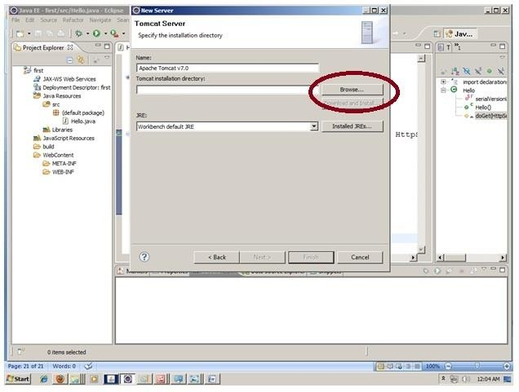
How to configure tomcat server in Eclipse ?

Slide 22
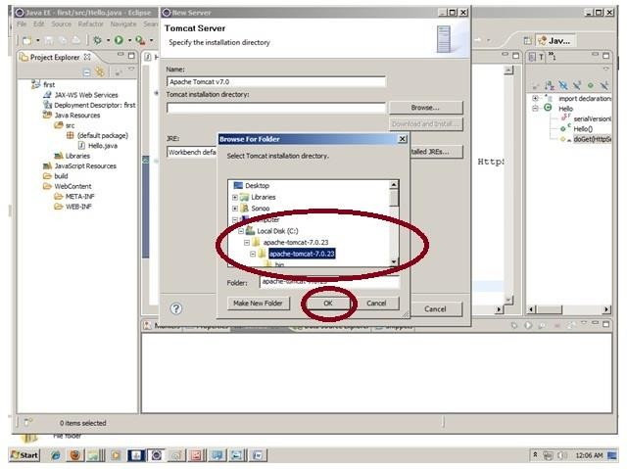
How to configure tomcat server in Eclipse ?

Slide 23
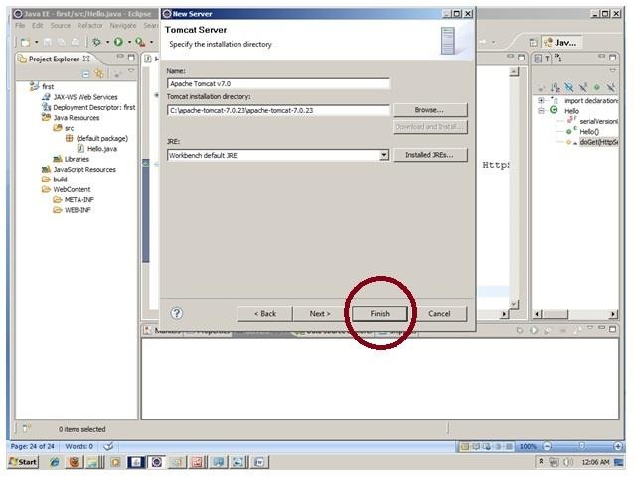
How to configure tomcat server in Eclipse ?

Slide 24
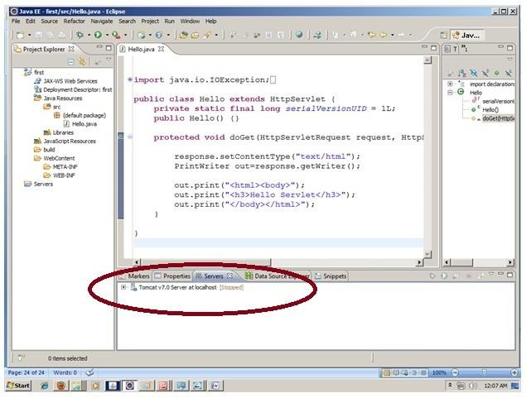
How to configure tomcat server in Eclipse ?

Slide 25
Steps to run servlet in Eclipse
Create a Dynamic web project
create a servlet
add servlet-api.jar file Run the servlet

Slide 26
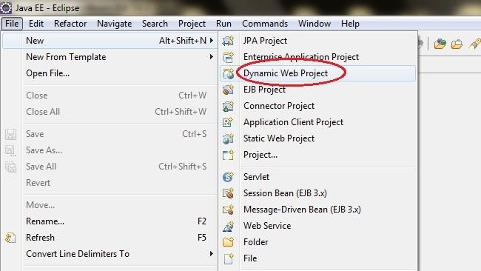
Create the dynamic web project
Start Eclipse and In Menu : File -> New -> Dynamic Web Project

Slide 27
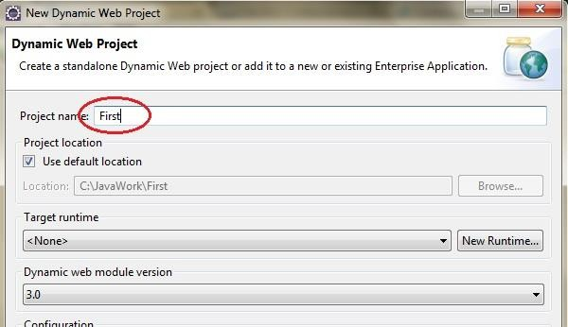
Create the dynamic web project

Slide 28
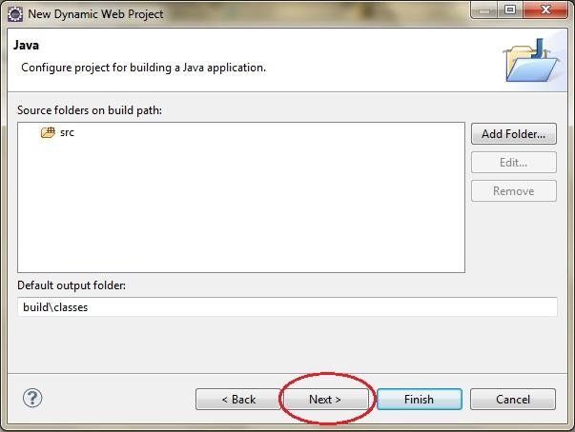
Create the dynamic web project

Slide 29
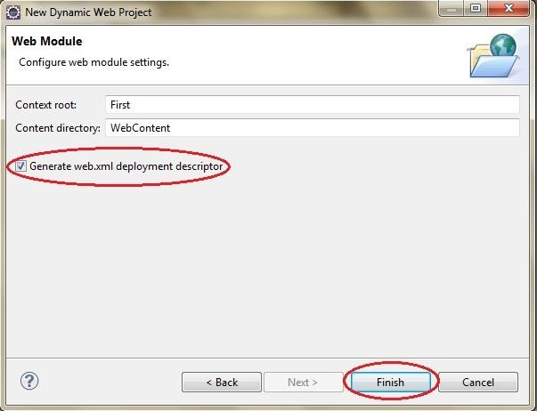
Create the dynamic web project

Slide 30
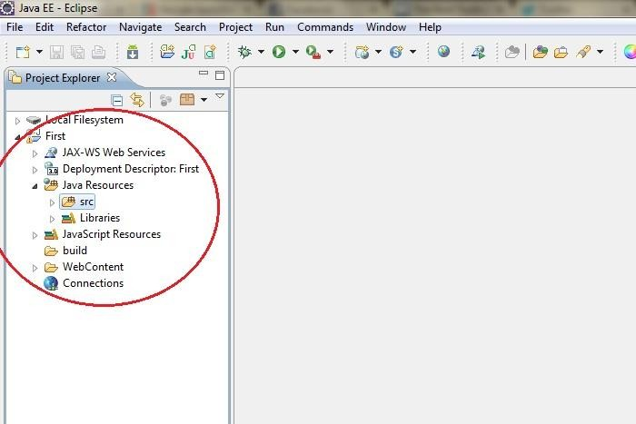
Create the dynamic web project
Structure of Dynamic Web Project

Slide 31
Steps to run servlet in Eclipse
Create a Dynamic web project
create a servlet
add servlet-api.jar file Run the servlet

Slide 32
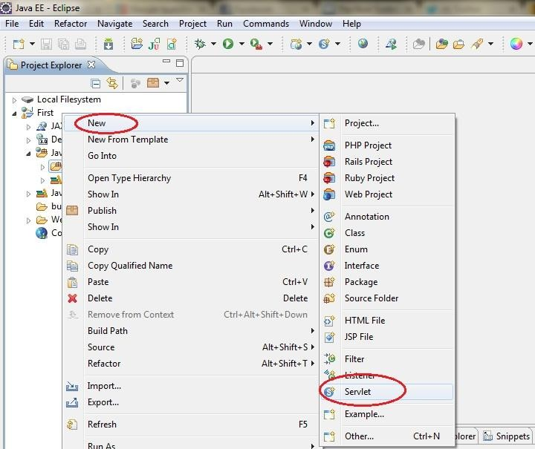
Create a servlet
Right click on Src -> New -> Sevlet

Slide 33
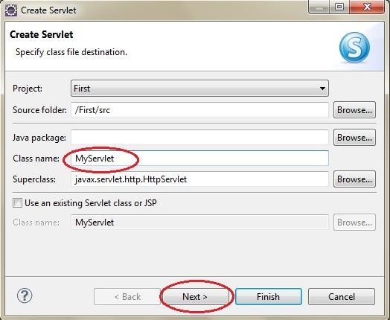
Create a servlet
Give name of class

Slide 34
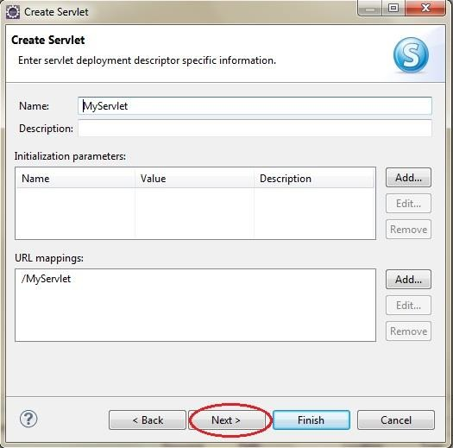
Create a servlet

Slide 35
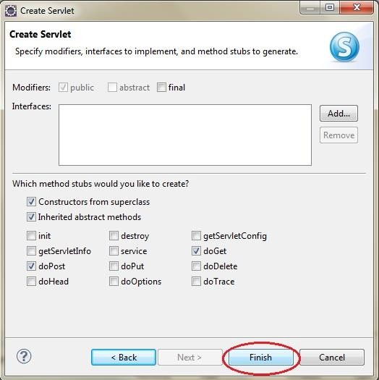
Create a servlet
Either select doGet or doPost

Slide 36
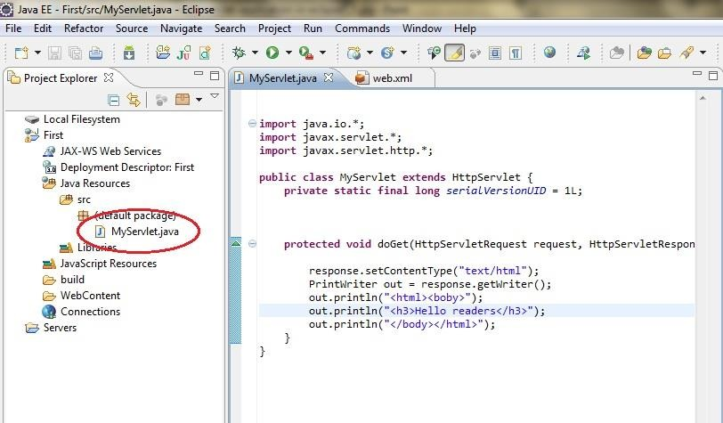
Create a servlet
Servlet is created, you can write the code now.

Slide 37
Steps to run servlet in Eclipse
Create a Dynamic web project
create a servlet
add servlet-api.jar file Run the servlet

Slide 38
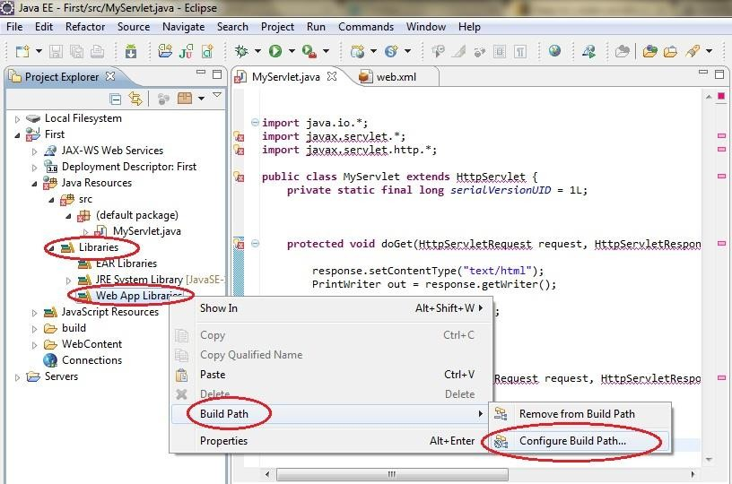
Add servlet-api.jar file

Slide 39
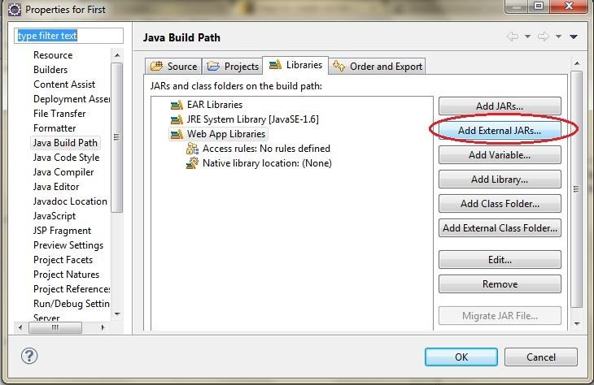
Add servlet-api.jar file

Slide 40
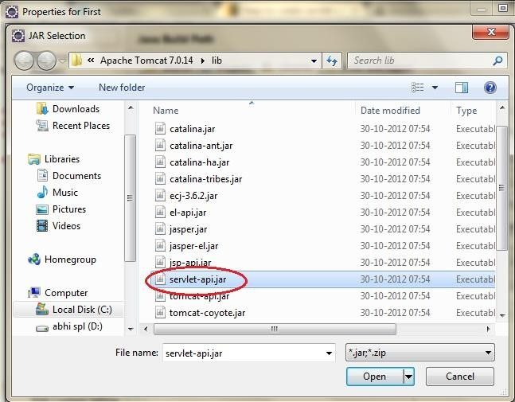
Add servlet-api.jar file
In Tomcat folder goto Lib folder and select servlet-api.jar file

Slide 41
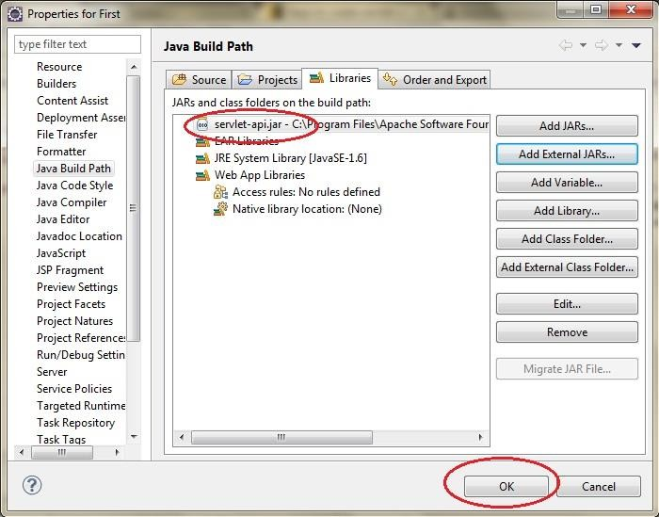
Add servlet-api.jar file

Slide 42
Steps to run servlet in Eclipse
Create a Dynamic web project
create a servlet
add servlet-api.jar file Run the servlet

Slide 43
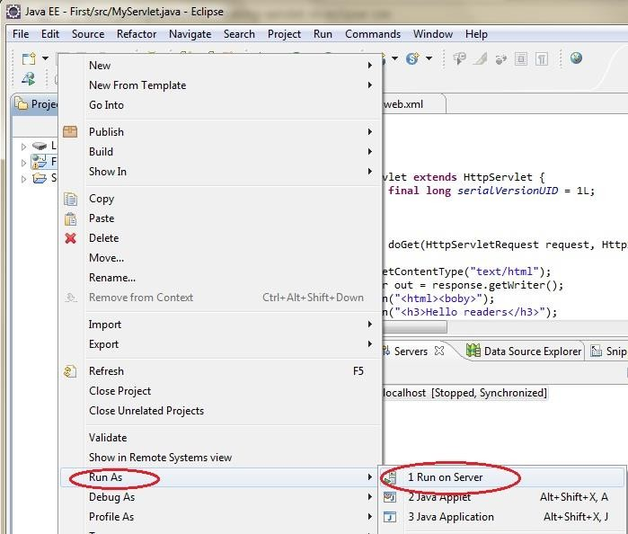
Run the servlet
Right click on project name -> click Run As -> Run on Server

Slide 44
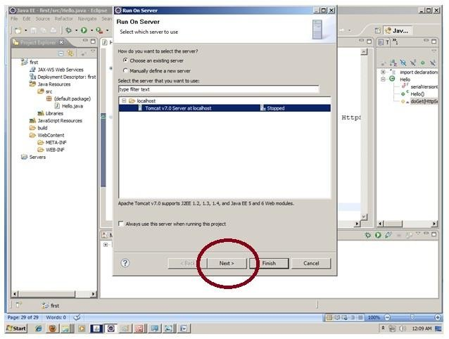
Run the servlet

Slide 45
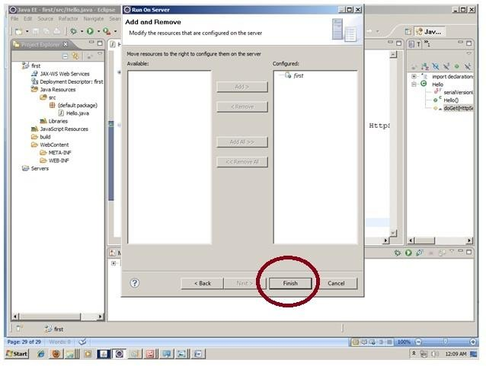
Run the servlet

Slide 46
Example 1-
To Print Hello World directly
import java.io.*; import javax.servlet.*;
import javax.servlet.http.*;
public class HelloWorld extends HttpServlet { public void init() throws ServletException { }
public void doGet(HttpServletRequest request, HttpServletResponse response) throws ServletException, IOException { response.setContentType("text/html");
PrintWriter out = response.getWriter(); out.println("<h1> Hello World </h1>");
}
public void destroy() { }
}

Slide 47
Example 2-
To Print Hello World using init() method
import java.io.*;
import javax.servlet.*;
import javax.servlet.http.*;
public class HelloWorld extends HttpServlet { private String message;
public void init() throws ServletException
{ message = "Hello World"; }
public void doGet(HttpServletRequest request, HttpServletResponse response) throws ServletException, IOException { response.setContentType("text/html");
PrintWriter out = response.getWriter();
out.println("<h1>" + message + "</h1>"); } public void destroy() { }
}

Slide 48
Reading Form Data using Servlet
getParameter() − You call request.getParameter() method to get the value of a form parameter.
getParameterValues() − Call this method if the parameter appears more than once and returns multiple values (for example checkbox)
getParameterNames() − Call this method if you want a complete list of all parameters in the current request.

Slide 49
Example 3-
To read data from HTML file and print it:
It requires 2 files:
1. HTML (s1.html)File
2. Servlet (s2.java) File
First Run HTML file and after clicking on submit button it will run servlet (.java) file.

Slide 50
Example 3-
To read data from HTML file and print that .
S1.html (html code)
<html>
<form method=“post” action=“s2”> Enter Your Name
<input type=text name=“t1”>
<br>
<input type=“submit” value=“submit”>
</form>
</body>
</html>

Slide 51
Example 3-
To read data from HTML file and print that .
S2.java (Servlet Code)
import java.io.*; import javax.servlet.*;
public class s2 extends HttpServlet {
public void doPost(HttpServletRequest request, HttpServletResponse
response) throws ServletException, IOException
{
response.setContentType("text/html"); String a= request.getParameter("t1"); PrintWriter out= response.getWriter(); out.print("<br>Your Name is: "+a);
}
}

Slide 52
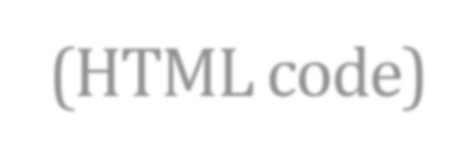

Example 4 –(HTML code)
To read data from HTML checkbox values print that
<!DOCTYPE html>
<html>
<body>
<form method="post" action="s1">
Hobbies
<input type="checkbox" name="t1" value=“Cricket"> Cricket
<input type="checkbox" name="t1" value="Music">Music
<input type="checkbox" name="t1" value=“Dance">Dance
<input type="submit" value="submit">
</form>
</body>
</html>
Name of Servlet File

Slide 53
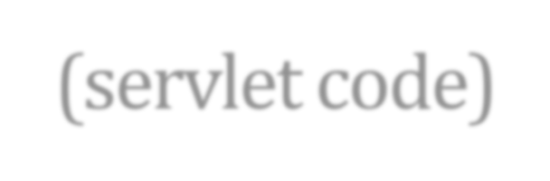
Example 4 –(servlet code)
To read data from HTML checkbox values print that
protected void doPost(HttpServletRequest request, HttpServletResponse response)
throws ServletException, IOException
{
response.setContentType("text/html");
PrintWriter out=response.getWriter();
String[] values=request.getParameterValues("t1");
for(int i=0;i<values.length;i++)
{
out.println("<li>"+values[i]+"</li>");
}
}

Slide 54
Example 5 –(HTML code)
To print complete list of all parameters
<!DOCTYPE html>
<html>
<body>
<form method="post" action=s1>
Hobbies
Enter Name <input type=“text" name="t1" > <br>
Enter Address <input type=“text" name="t2" > <br>
Enter Class <input type=“text" name="t3" > <br>
<input type="submit" value="submit">
</form>
</body>
</html>

Slide 55
Example 5 –(Servlet code)
To print complete list of all parameters
protected void doPost(HttpServletRequest request, HttpServletResponse response) throws ServletException, IOException
{
response.setContentType("text/html"); PrintWriter out = response.getWriter();
Enumeration e = request.getParameterNames(); while(e.hasMoreElements())
{
Object obj = e.nextElement(); out.println((String) obj+ "<br>");
}
}

Slide 56
Database and Servlets
To start interfacing Java Servlet Program with JDBC Connection:
Proper JDBC Environment should set-up along with database creation.
To do so, download the mysql-connector.jar file from the internet.
As it is downloaded, move the jar file to the apache-tomcat server folder.
Place this jar file in lib folder present in the apache-tomcat directory.

Slide 57
Step 1: Creation of Database and Table in MySQL
mysql> create table users (username varchar(20), password varchar(20));

Slide 58
Step 2: Implementation of required Web-pages
Create a form in HTML file, where take all the inputs required to insert data into the database.
Specify the servlet name in it, with the POST method as security is important aspects in database connectivity.

Slide 59
Client Side Program- HTML Page
<HTML>
<BODY>
<FORM ACTION="http://localhost:8080/examples/servlet/Login" METHOD="GET">
username: <INPUT NAME="un" TYPE=TEXT> <BR>
password: <INPUT NAME="pw" TYPE=PASSWORD> <BR>
<INPUT TYPE="SUBMIT" VALUE="login">
<INPUT TYPE="RESET" VALUE="cancel">
</FORM>
</BODY>
</HTML>

Slide 60
Server Side Program - Servlet
import javax.servlet.*;
import javax.servlet.http.*;
import java.io.*;
import java.sql.*;
public class Login extends HttpServlet
{
Connection conn;
public void doGet(HttpServletRequest req, HttpServletResponse res) throws
ServletException, IOException
{
PrintWriter out;
String u, p;
u= req.getParameter("un");
p= req.getParameter("pw");
out=res.getWriter();
try
{
Class.forName("com.mysql.jdbc.Driver");

Slide 61
Continued…
conn=DriverManager.getConnection("jdbc:mysql://localhost:3306/vij","root","admin");
PreparedStatement ps = conn.prepareStatement ("select username, password from users where username = ? and password = ?");
ps.setString(1, u);
ps.setString(2, p);
ResultSet rs = ps.executeQuery();
res.setContentType("text/html");
if (rs.next())
{
out.println("<HTML> <BODY>");
out.println("<H1>Welcome "+u+ "</H1>");
out.println("</BODY></HTML>");
}
else
{
out.println("<HTML> <BODY>");
out.println("<H1>Invalid credentials</H1>");
out.println("</BODY></HTML>");
}
conn.close();
}

Slide 62
Continued…
catch (ClassNotFoundException e)
{ out.println(e.getMessage()); }
catch(SQLException e)
{ out.println(e.getMessage()); }
}
public void doPost(HttpServletRequest req, HttpServletResponse res) throws ServletException, IOException
{
doGet(req , res);
}
}

Slide 63
Session Tracking (Management)
Session Tracking is a way to maintain state (data) of an user. It is also known as session management in servlet.
Http protocol is stateless so we need to maintain state using some mechanism.
Each time user requests to the server, server treats the request as the new request.
So we need to maintain the state of an user to recognize any particular user.

Slide 64
Session Tracking Techniques
Cookies
Hidden Form Field URL Rewriting HttpSession

Slide 65
Session Tracking- Using Cookies
A cookie is a small textual information stored in key-value pair format on the client browser, that is persisted between the multiple client requests.
A cookie has a name, a single value and some optional attributes such as a comment, site name/ domain qualifiers, a maximum age and a version number.
How Cookie works:
In cookies technique, we add cookie with response from the servlet.
So now, cookie is stored in the cache of the browser.
After that if any subsequent requests are again sent by the user, this cookie is added with request by default.
Thus, server recognizes the user as an old user.

Slide 66
Session Tracking- Using Cookies
Types of Cookie:
Non-persistent cookie
Persistent cookie
Non-persistent cookie:
It is valid for single session only. It is removed each time when user closes the browser.
Persistent cookie:
It is valid for multiple session . It is not removed each time when user closes the browser.
It is removed only if user logs out or signs out.

Slide 67
Session Tracking- Using Cookies
Advantage of Cookies
Simplest technique of maintaining the state.
Cookies are maintained at client side.
Disadvantage of Cookies
It will not work if cookie is disabled from the browser.
Only textual information can be set in a Cookie object.

Slide 68
Session Tracking- Using Cookies
Useful Methods of Cookie class
Method | Description
public void setMaxAge(int expiry) | Sets the maximum age of the cookie in seconds.
public String getName() | Returns the name of the cookie. The name cannot be changed after creation.
public String getValue() | Returns the value of the cookie.
public void setName(String name) | changes the name of the cookie.
public void setValue(String value) | changes the value of the cookie.

Slide 69
Session Tracking- Using Cookies
How to create Cookie?
//creating cookie object
Cookie ck=new Cookie("user","Manish");
//adding cookie in the response
response.addCookie(ck);
How to delete Cookie?
//create cookie with same name and set value to empty string
Cookie ck=new Cookie("user","");
ck.setMaxAge(0); //changing the maximum age to 0 seconds
response.addCookie(ck); //adding cookie in the response
How to get Cookies?
Cookie ck[]=request.getCookies();
for(int i=0;i<ck.length;i++){
//printing name and value of cookie
out.print("<br>"+ck[i].getName()+" "+ck[i].getValue());
}

Slide 70
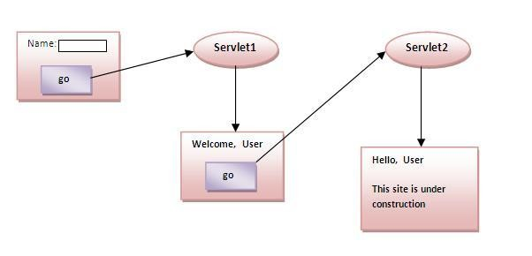
Session Tracking- Using Cookies Simple example of Servlet Cookies

Slide 71
Session Tracking- Using Cookies Simple example of Servlet Cookies
index.html
<form action="servlet1" method="post">
Name: <input type="text" name="userName"/> <br/>
<input type="submit" value="go"/>
</form>

Slide 72
Session Tracking- Using Cookies Simple example of Servlet Cookies
Servlet1.java
import java.io.*; import javax.servlet.*;
import javax.servlet.http.*;
public class FirstServlet extends HttpServlet {
public void doPost(HttpServletRequest request, HttpServletResponse response)
{ try{
response.setContentType("text/html"); PrintWriter out = response.getWriter(); String n=request.getParameter("userName"); out.print("Welcome "+n);
Cookie ck=new Cookie("uname",n);
response.addCookie(ck); //adding cookie in the response
//creating submit button to navigate to servlet-2
out.print("<form action='servlet2'>"); out.print("<input type='submit' value='go'>"); out.print("</form>");
out.close();
}catch(Exception e){System.out.println(e);}
}
}

Slide 73
Session Tracking- Using Cookies Simple example of Servlet Cookies
Servlet2.java
import java.io.*; import javax.servlet.*;
import javax.servlet.http.*;
public class SecondServlet extends HttpServlet {
public void doPost(HttpServletRequest request, HttpServletResponse response){ try{
response.setContentType("text/html"); PrintWriter out = response.getWriter();
Cookie ck[]=request.getCookies(); out.print("Hello, "+ck[0].getValue());
out.close();
}catch(Exception e){System.out.println(e);}
}
}

Slide 74
Session Tracking Techniques
Cookies
Hidden Form Field URL Rewriting HttpSession

Slide 75
Session Tracking- Hidden Form Fields
In case of Hidden Form Field, a hidden (invisible) textfield is used for maintaining the state of an user.
In such case, we store the information in the hidden field and get it from another servlet.
Syntax:
<input type="hidden" name="username" value=“Bhavana">
Here, username is the hidden field name and Bhavana is the
hidden field's value.

Slide 76
Session Tracking- Hidden Form Fields
Advantage of Hidden Form Field:
It will always work whether cookie is disabled or not.
Disadvantage of Hidden Form Field:
It is maintained at server side.
Extra form submission is required on each pages.
Only textual information can be used.

Slide 77
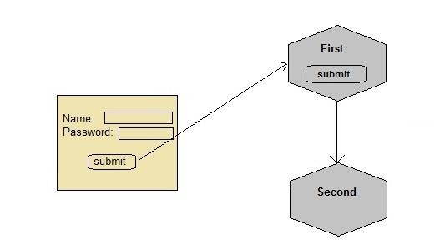
Session Tracking- Hidden Form Fields Example of passing username

Slide 78
Session Tracking- Hidden Form Fields Example of passing username
index.html
<form method="post" action=“First">
Name: <input type="text" name="user" /> <br/>
Password: <input type="text" name="pass" > <br/>
<input type="submit" value="submit">
</form>

Slide 79
Session Tracking- Hidden Form Fields Example of passing username
First.java
import java.io.*; import javax.servlet.*;
import javax.servlet.http.*;
public class First extends HttpServlet {
protected void doPost(HttpServletRequest request, HttpServletResponse response) throws ServletException, IOException {
response.setContentType("text/html;charset=UTF-8"); PrintWriter out = response.getWriter();
String user = request.getParameter("user");
//creating a new hidden form field out.println("<form action='Second'>");
out.println("<input type='hidden' name='user' value='"+user+"'>"); out.println("<input type='submit' value='submit' >"); out.println("</form>");
}
}

Slide 80
Session Tracking- Hidden Form Fields Example of passing username
Second.java
import java.io.*; import javax.servlet.*;
import javax.servlet.http.*;
public class Second extends HttpServlet {
protected void doGet(HttpServletRequest request, HttpServletResponse response)
throws ServletException, IOException { response.setContentType("text/html ");
PrintWriter out = response.getWriter();
//getting parameter from the hidden field String user = request.getParameter("user"); out.println("Welcome "+user);
}
}

Slide 81
Session Tracking Techniques
Cookies
Hidden Form Field URL Rewriting HttpSession

Slide 82
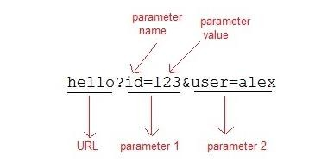
Session Tracking- URL Rewriting
If the client has disabled cookies in the browser then session management using cookie won't work.
In that case URL Rewriting can be used as a backup as URL rewriting will always work.
In URL rewriting, a token (parameter) is added at the end of the URL.
The token consist of name-value pair separated by an equal(=) sign.
For Example:

Slide 83
Session Tracking- URL Rewriting
When the User clicks on the URL having parameters, the request goes to the Web Container with extra bit of information at the end of URL.
The Web Container will fetch the extra part of the requested URL and use it for session management.
The getParameter() method is used to get the parameter
value at the server side.
Advantage of URL Rewriting:
It will always work whether cookie is disabled or not (browser independent).
Extra form submission is not required on each pages.
Disadvantage of URL Rewriting:
It will work only with links.
It can send only textual information.

Slide 84
Session Tracking- URL Rewriting Example
index.html
<form method="post" action="validate">
Name:<input type="text" name="user" /> <br/>
Password:<input type="text" name="pass" > <br/>
<input type="submit" value="submit">
</form>

Slide 85
Session Tracking- URL Rewriting Example
Validate.java
import java.io.*;
import javax.servlet.*; import javax.servlet.http.*;
public class MyServlet extends HttpServlet {
protected void doPost(HttpServletRequest request, HttpServletResponse response) throws ServletException, IOException {
response.setContentType("text/html;charset=UTF-8");
String name = request.getParameter("user"); String pass = request.getParameter("pass");
if(pass.equals("1234")) {
response.sendRedirect("First?user_name="+name);
}
}
}

Slide 86
Session Tracking- URL Rewriting Example
First.java
import java.io.*; import javax.servlet.*;
import javax.servlet.http.*;
public class First extends HttpServlet {
protected void doGet(HttpServletRequest request, HttpServletResponse response)
throws ServletException, IOException {
response.setContentType("text/html;charset=UTF-8"); PrintWriter out = response.getWriter();
String user = request.getParameter("user_name");
out.println("Welcome, "+user);
}
}

Slide 87
Session Tracking Techniques
Cookies
Hidden Form Field URL Rewriting HttpSession

Slide 88
Session Tracking- using HttpSession
The servlet container uses this interface to create a session between an HTTP client and an HTTP server.
The session persists for a specified time period, across more than one connection or page request from the user.
Firstly, you would get HttpSession object by calling the public method getSession() of HttpServletRequest, as below −
HttpSession session = request.getSession();
Then, to store the values of the session, the values are bind with a session object (variable) using the setAttribute() method and then retrieved later using the getAttribute()method:
session.setAttribute(“session_variable_name”, value_object);
session.getAttribute(“session_variable_name”);

Slide 89


Session Tracking- HttpSession
How to get the HttpSession object ?
public HttpSession getSession():Returns the current session associated with this request, or if the request does not have a session, creates one.
Commonly used methods of HttpSession interface:
public String getId():Returns unique identifier value.
public String getAttribute(): Returns value of the specified session variable
public long getCreationTime():Returns the time when this session was created.
public long getLastAccessedTime():Returns the last time the client sent a request associated with this session.
public void invalidate():Invalidates this session and then unbinds any objects bound to it.

Slide 90
Session Tracking- HttpSession Example for Hit Count
HTML File
<h3>Hit Count Example with HttpSession</h3>
<form method="get" action=“HitCount"> Click for Hit Count
<input type="submit" value="GET HITS">
</form>
</body>

Slide 91
Session Tracking- HttpSession Example for Hit Count
public class HitCount extends HttpServlet
{
public void service(HttpServletRequest req, HttpServletResponse res) throws
ServletException, IOException {
res.setContentType("text/html") ; PrintWriter out = res.getWriter( ); HttpSession session = req.getSession();
Integer hitNumber = (Integer) session.getAttribute("Rama");
if (hitNumber == null)
{ hitNumber = new Integer(1);
}
else
{ hitNumber = new Integer(hitNumber .intValue()+1) ;
}
session.setAttribute("rama", hitNumber); // storing the value with a session object

Slide 92
out.println("Your Session ID: " + session.getId());
out.println("<br>Session Creation Time: " + new Date (session.getCreationTime()));
out.println("<br>Time of Last Access: " + new Date (session.getLastAccessedTime()) );
out.println("<br>Latest Hit Count: " + hitNumber);
}
}

Slide 93
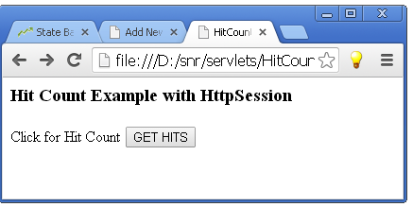

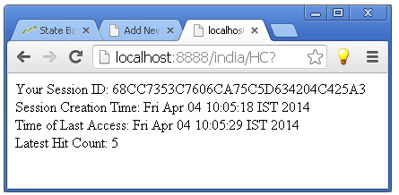
Session Tracking- HttpSession Example Hit Count output

Slide 94
Servlet Quiz Link:
https://forms.office.com/r/vVFGNz5j9G

Slide 95
Assignment-3
Create a login web page & servlet to statically authenticate the user. After authenticating the user, the login servlet must set a cookie related to username and must maintain the hit-count in other cookie. Each time the user logs-in successfully, retrieve the username from the cookie and correspondingly retrieve the hit-count from the other cookie (based on the username) & increment it.
Then, redirect the user to your web-profile page (created in assignment-1) by embedding the username & hit-count as URL parameters in the web-profile URL. On the web-profile page, use javascript/jquery to extract the username and hit-count from the URL and display them on top right corner of the web-profile page.
Hint: In javascript, use window.location.search to get the URL’s parameter string. Pass this string to the constructor of URLSearchParams class to parse this parameter string into key-value pairs.

